Slide 1

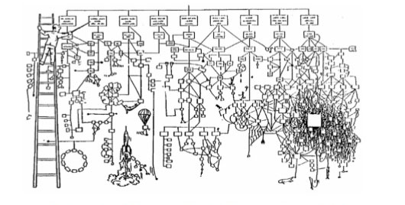
Refactoring Legacy Code
Dmytro Mindra
Unity Technologies/ Ciklum
Odessa, Ukraine

Slide 2
//When I wrote this, only God and I understood what I was doing
//Now, God only knows

Slide 3
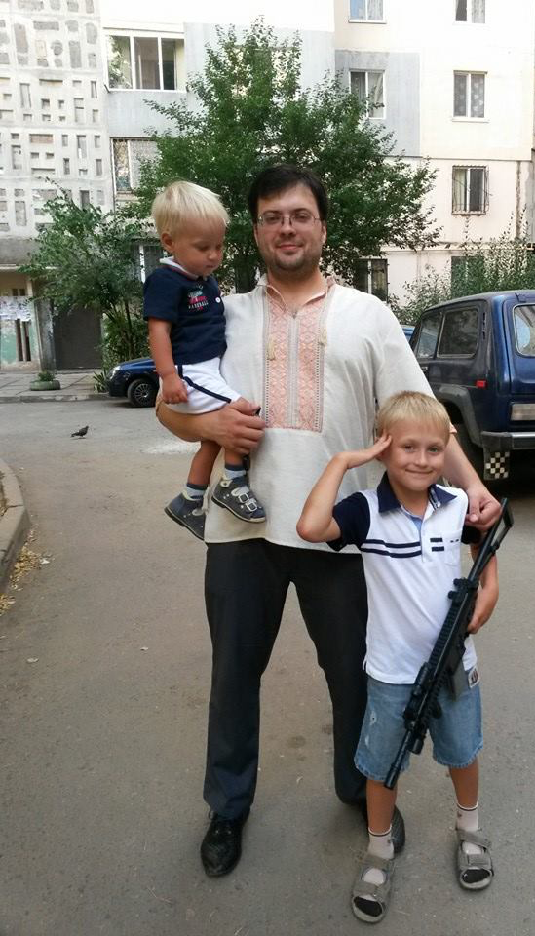
Dmytro Mindra
Software Development Engineer in Test
http://www.infoq.com/author/Dmytro-Mindra
http://blogs.unity3d.com/ru/author/dmitriy/
2010 - Lohika
2012 - Microsoft
2013 - Unity Technologies

Slide 4
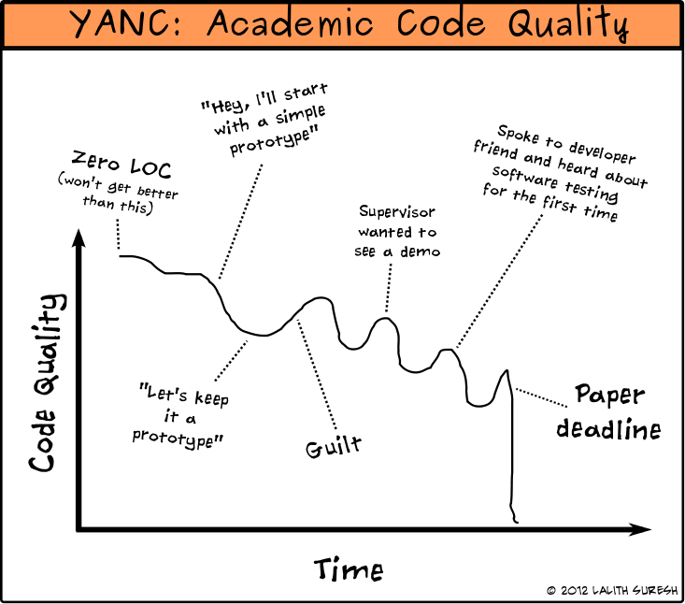

Slide 5
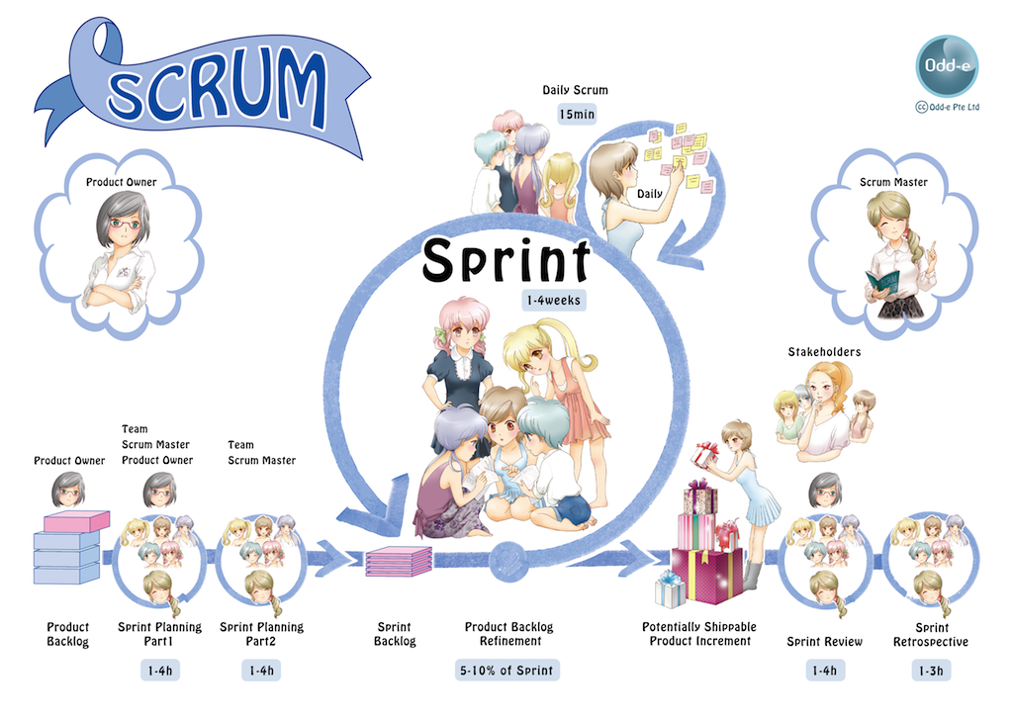
Notes:
http://www.scrumprimer.org/anime
Scrum got lots of focus today, but it focuses on people issues not on technical

Slide 6
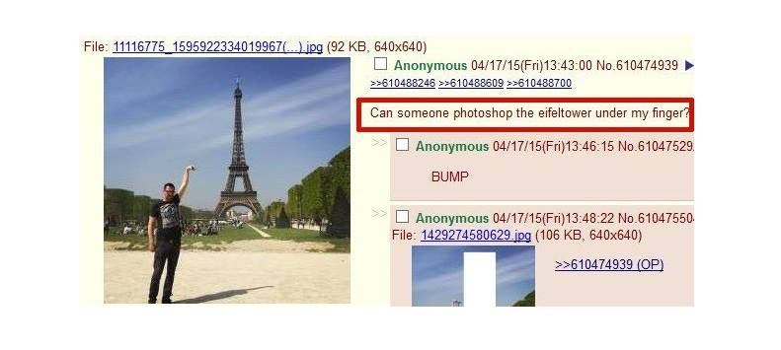
Developers are Brave

Slide 7
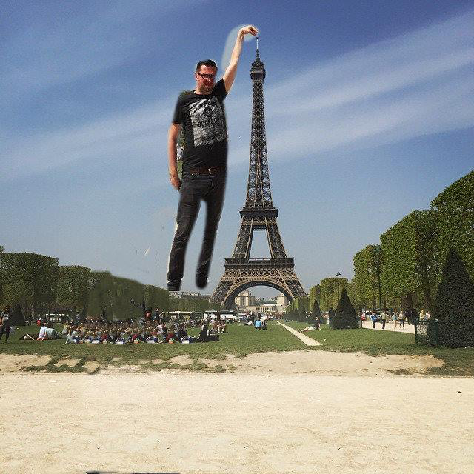

Slide 8
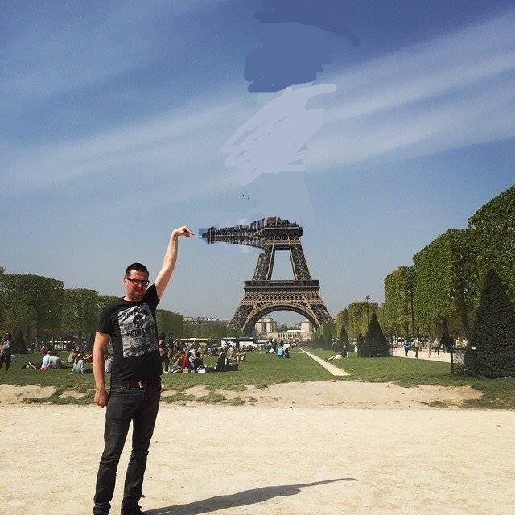

Slide 9
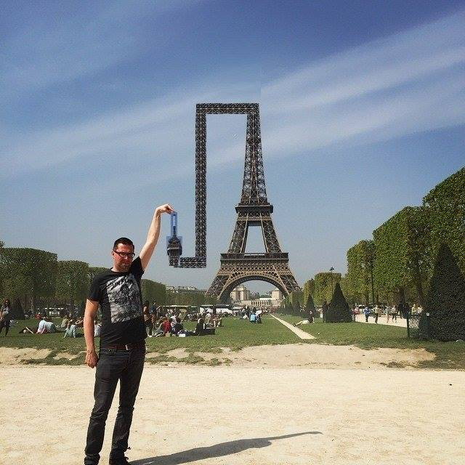

Slide 10
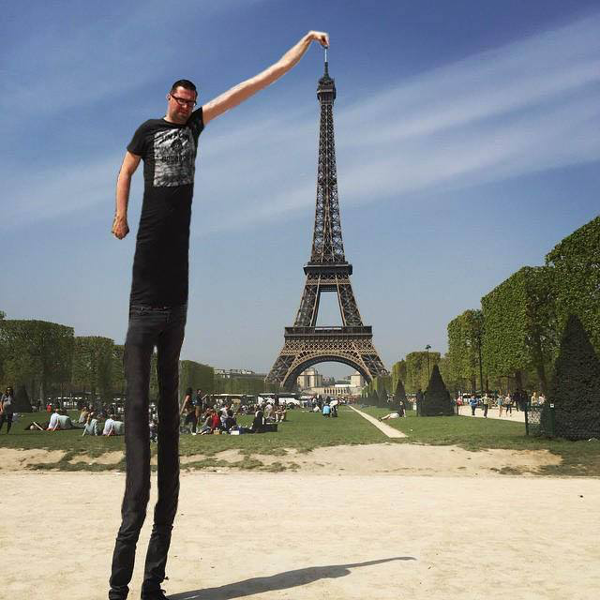

Slide 11
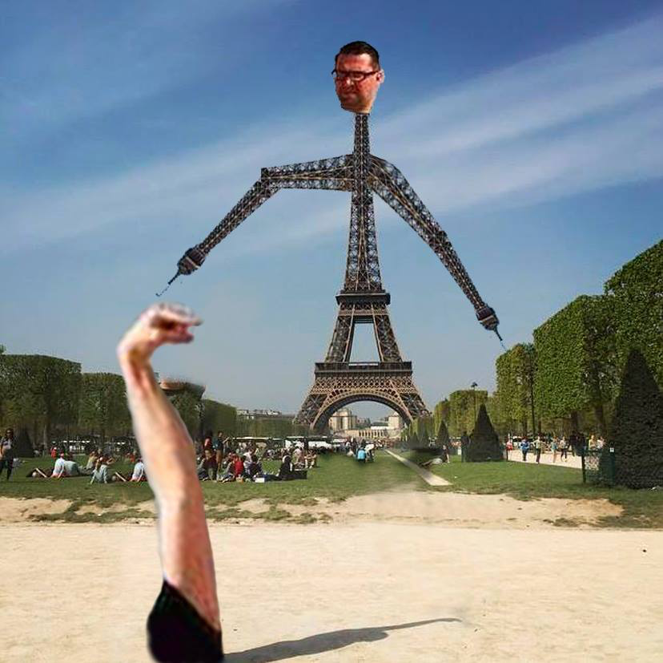

Slide 12
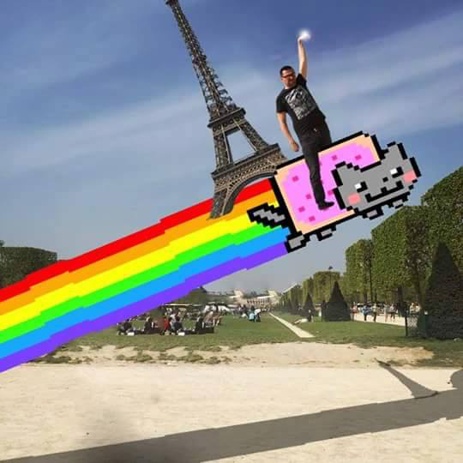

Slide 13
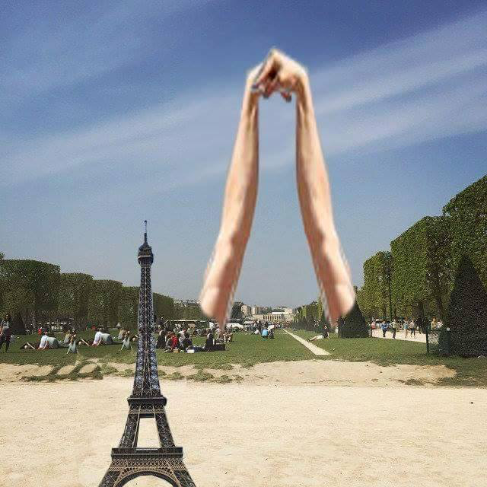

Slide 14
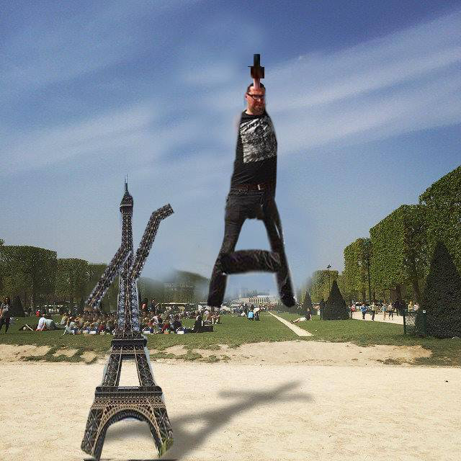

Slide 15
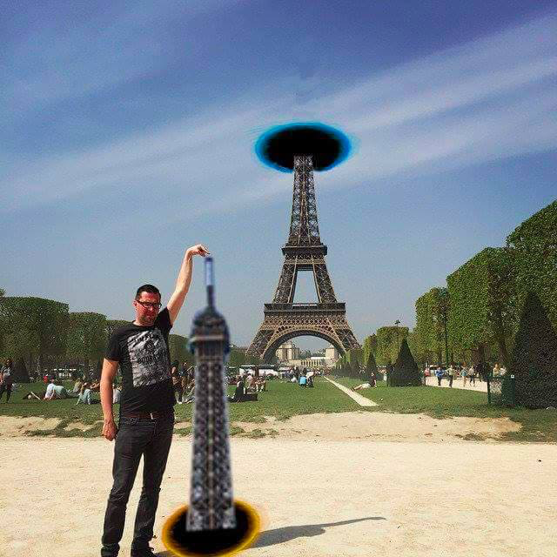

Slide 16
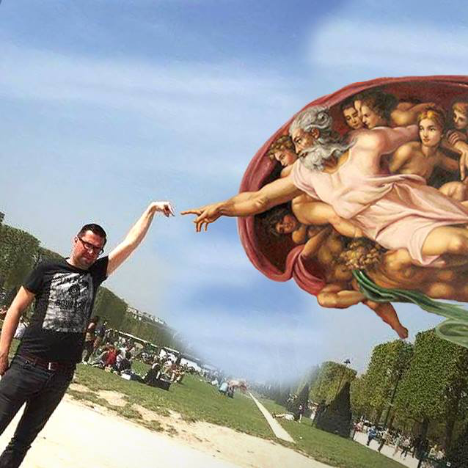

Slide 17
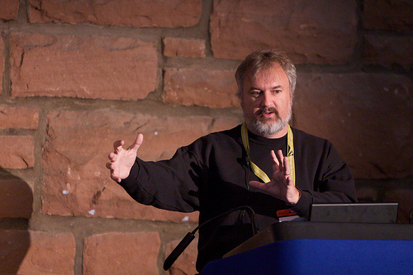

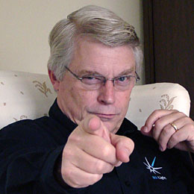
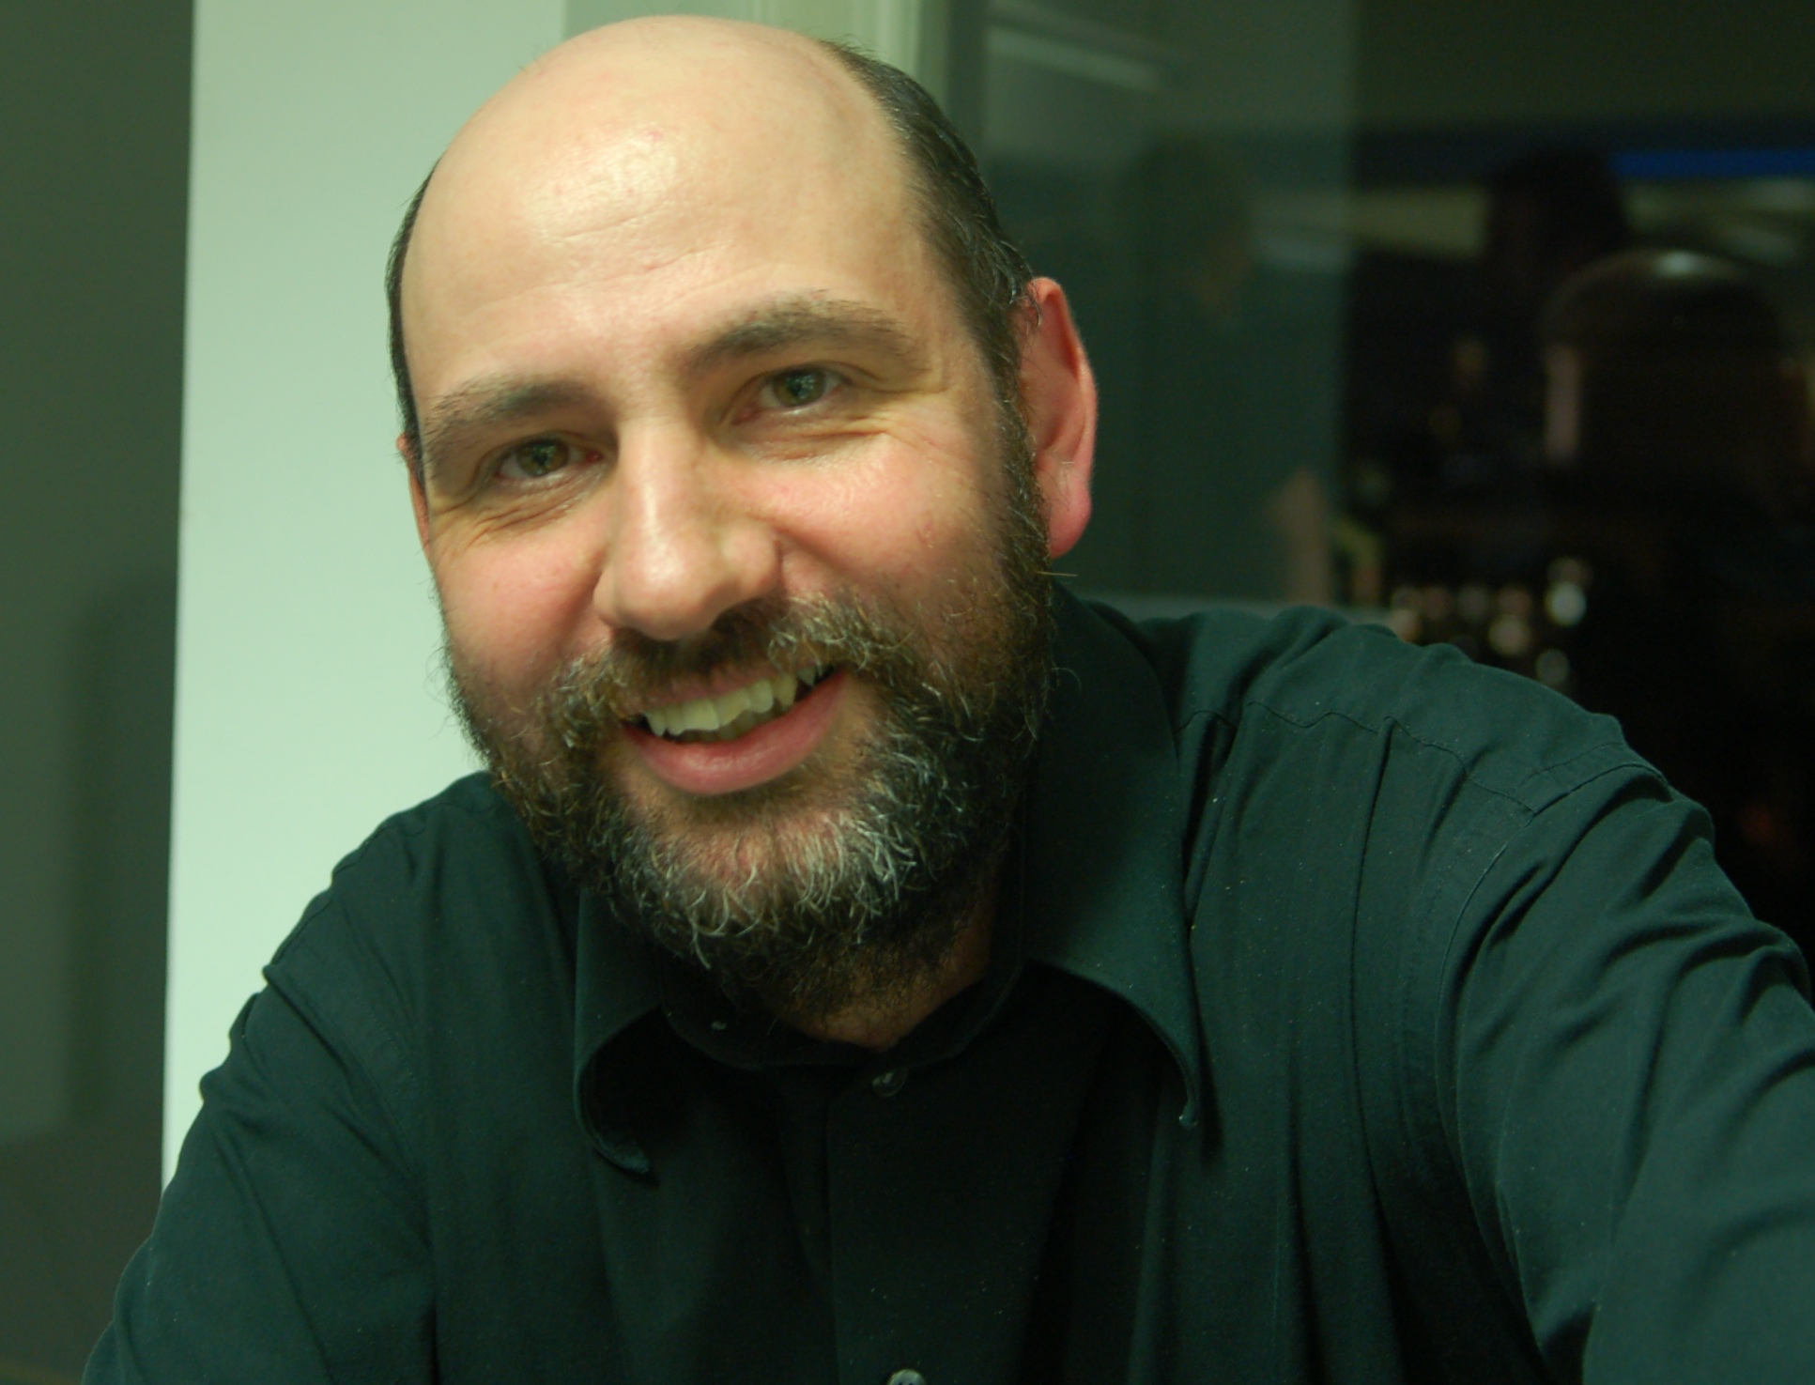

Slide 18
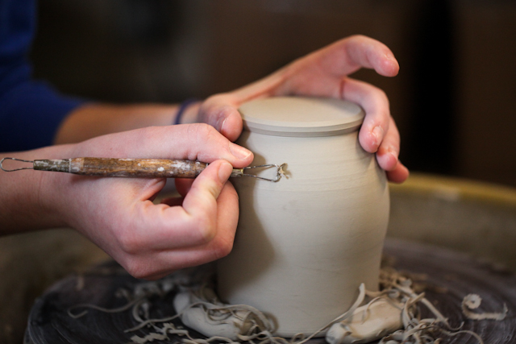
Software Craftsmanship
Notes:
http://en.wikipedia.org/wiki/Software_craftsmanship

Slide 19
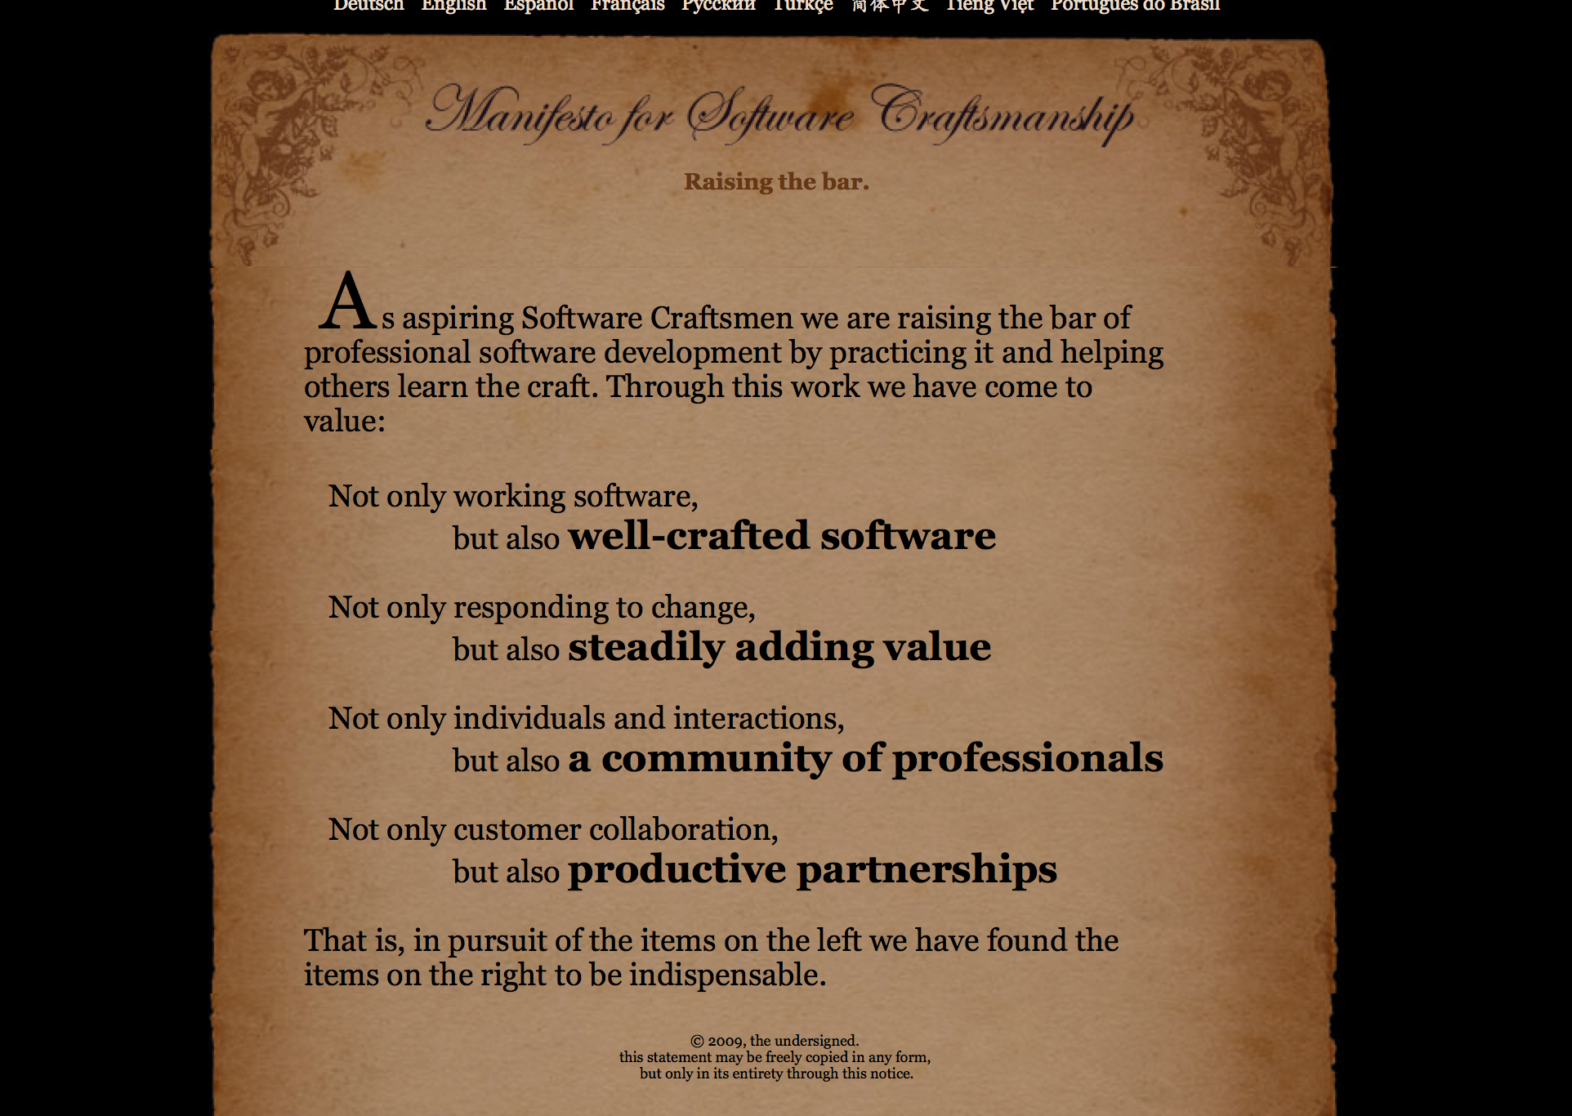
Notes:
http://manifesto.softwarecraftsmanship.org

Slide 20
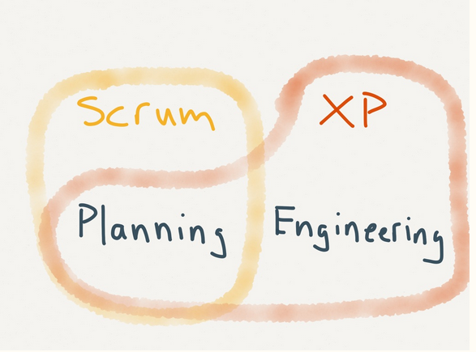
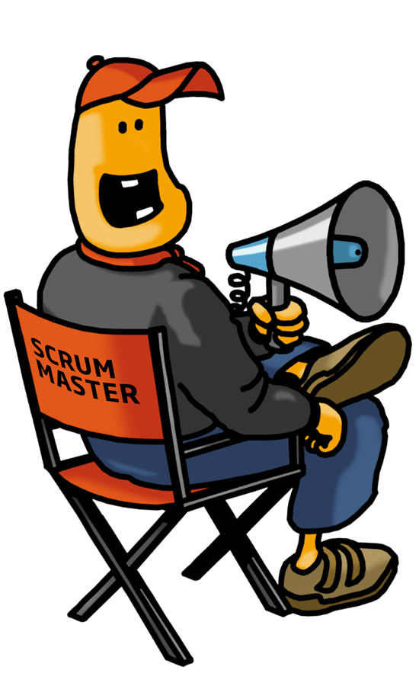
Scrum эра

Slide 21
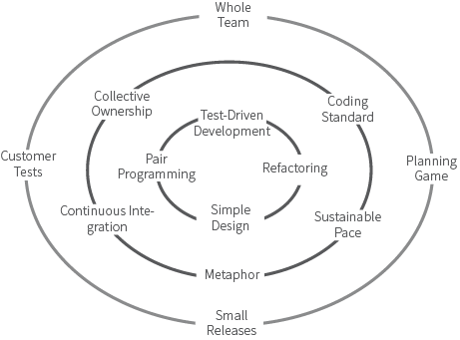
Extreme Programming (XP)

Slide 22
"Refactoring is the process of changing a software system in such a way that it does not alter the external behavior of the code yet improves its internal structure." -- MartinFowler

Slide 23
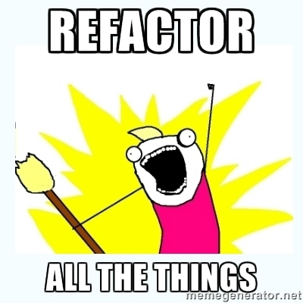
What do developers want?

Slide 24
Are you going to refactor with good intention(goal) in your mind?
Bug Fixing - 5.0 and 5.1
Fixing Disabled Tests
Writing new Native Tests
Refactoring
Is your goal measurable?
Can you prove that code Is better now?

Slide 25
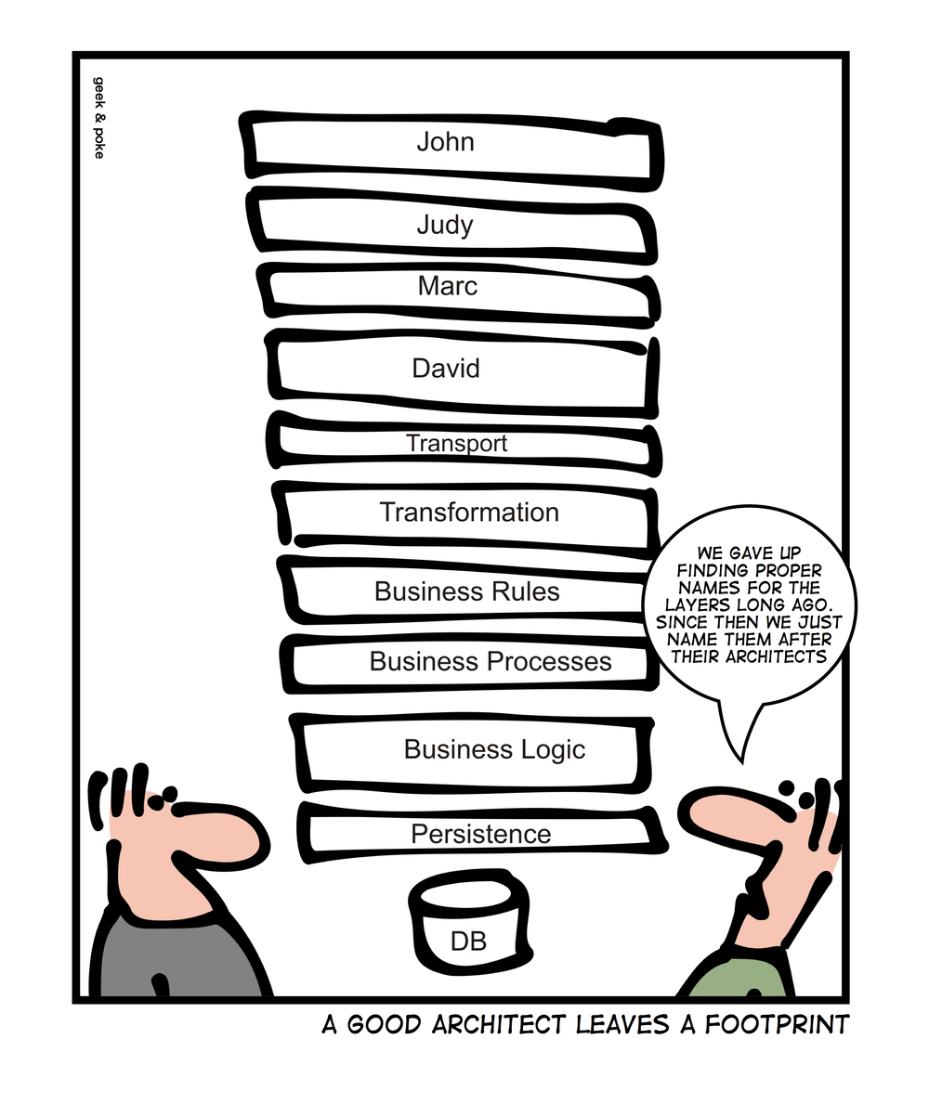

Slide 26
What is good? What are the Values?
Features
Design
Feedback
http://www.jbrains.ca/permalink/the-three-values-of-software

Slide 27
 | Make it Fast | Refactoring | Big Design Upfront
Features | + | - | -
Design | - | + | -
Feedback | + | - | -

Slide 28
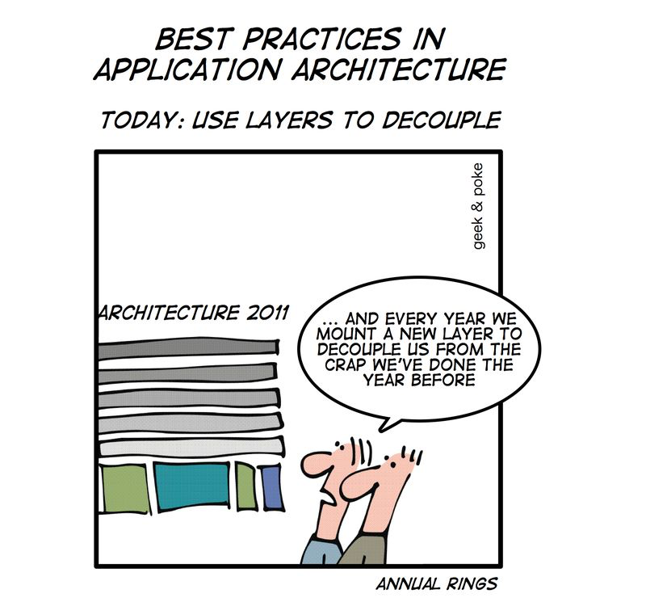
How can you measure you design?

Slide 29
Measuring your Design
WTF per minute
Cyclomatic complexity
Number of Classes
Length of hierarchy
Code Coverage

Slide 30
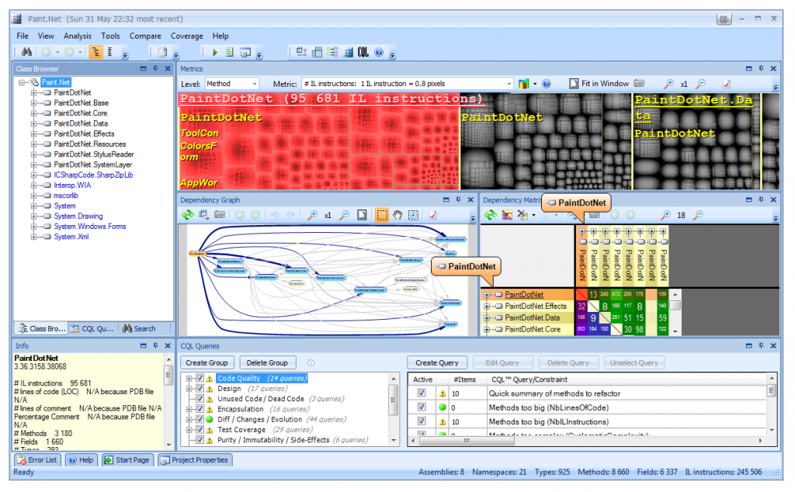
NDepend

Slide 31
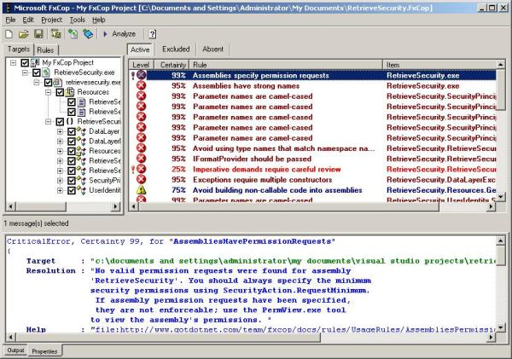
FxCop

Slide 32
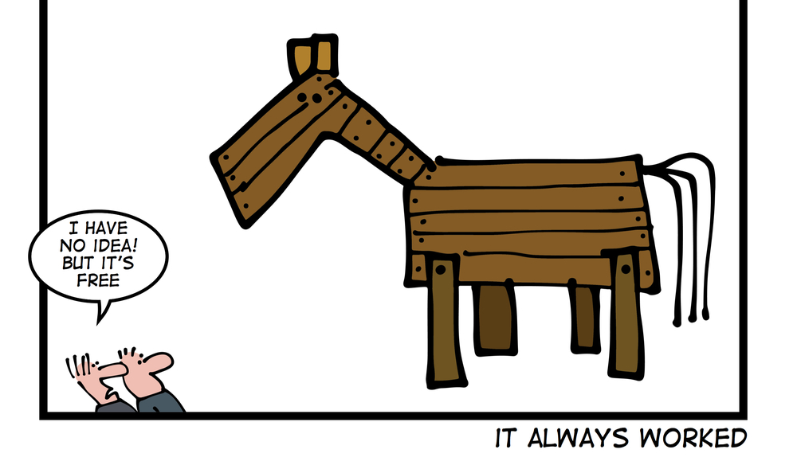
Tracing the History
When you are going to add another library
You can’t improve if you don’t know how your code has performed in the past

Slide 33
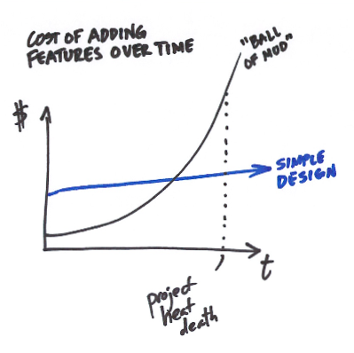
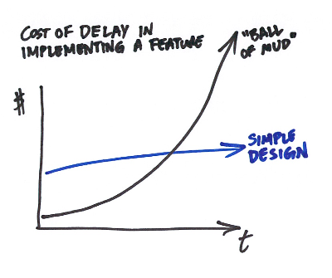
Big Refactoring

Slide 34
Good Refactoing
Done regularly
Done in small steps
Brings measurable value
Is always measured and quantified

Slide 35
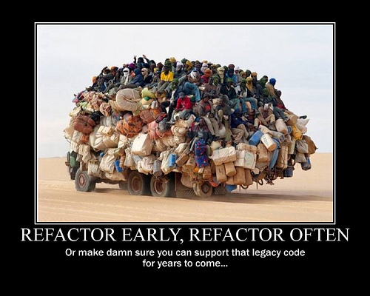

Slide 36
// I dedicate all this code, all my work, to my wife, Darlene, who will
// have to support me and our three children and the dog once it gets
// released into the public.

Slide 37
"A true legacy gets better with age."
---Uncle Bob
Notes:
http://blog.8thlight.com/uncle-bob/2014/04/03/Code-Hoarders.html

Slide 38

What do you call “legacy code”?
Code without tests
Code without specification
Code written long time ago.
…
MakeFlagWavingBastardWaveHisFlagWhichIsTheProbablyTheLastThingHeWillEverDo()
Found in Carmageddon 1 debugging symbols dumped

Slide 39
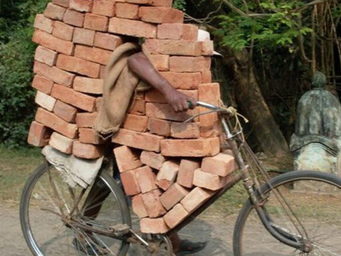
Legacy code – any code that you are afraid to change.

Slide 40

Where does Legacy Code come from?

Slide 41
Legacy code origins
Need more features (mine more minerals)
Changing requirements
AdHoc solutions (dirty)
Frequent change of developers
There is no tomorrow (at least for your developers)

Slide 42
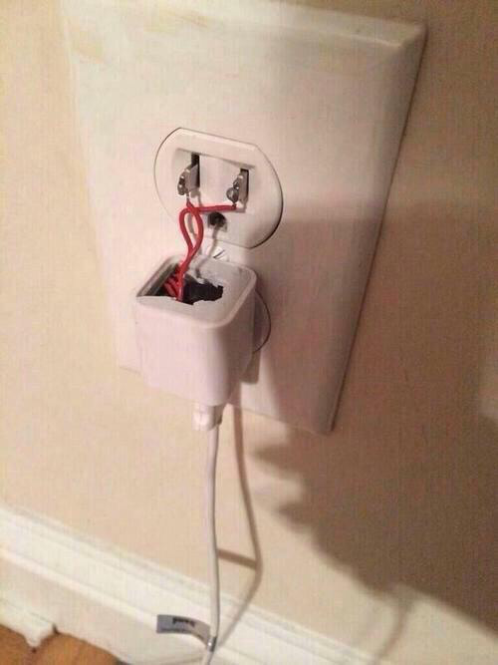
Golden rule of software development
It works - don’t touch it!

Slide 43
Why do we change the code ?
To add a feature
To fix a bug
To increase performance
We change the code with some concrete
and measurable goal in mind!

Slide 44
// drunk, fix later

Slide 45
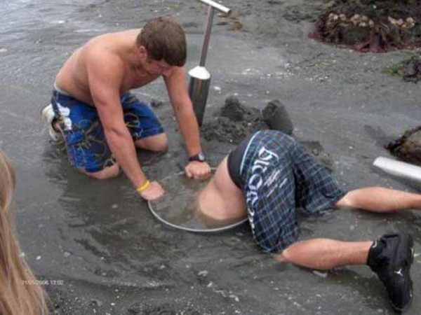
Maintenance is inevitable

Slide 46
How to work with legacy code?
Rewrite it from scratch ( bad idea)
Find new job …
Make it a «non legacy» code.

Slide 47

The most popular technique to deal with Legacy Code
Edit and pray

Slide 48
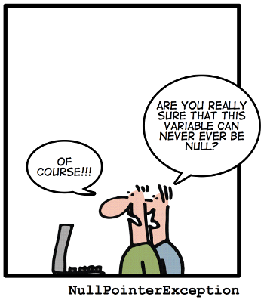
http://geek-and-poke.com
Notes:
Code Contracts

Slide 49
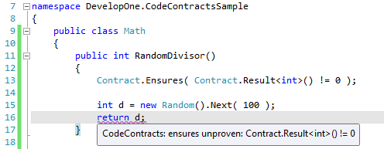
Code Contracts and Static Code Analysis

Slide 50

A much better option
Cover and Modify

Slide 51
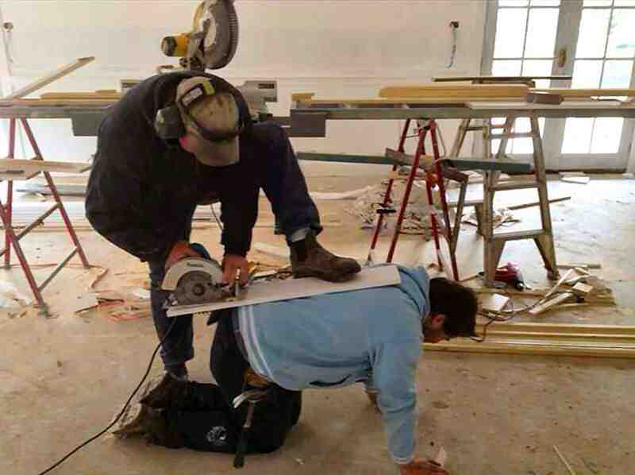
Working with Legacy Code is all about “Safety”

Slide 52
Getting Started
Identify change points
Find test points
Break dependencies
Write tests
Make changes

Slide 53
Where to start?
Identify change points
Legacy code is usually hard to understand
Change points are usually highly distributed

Slide 54
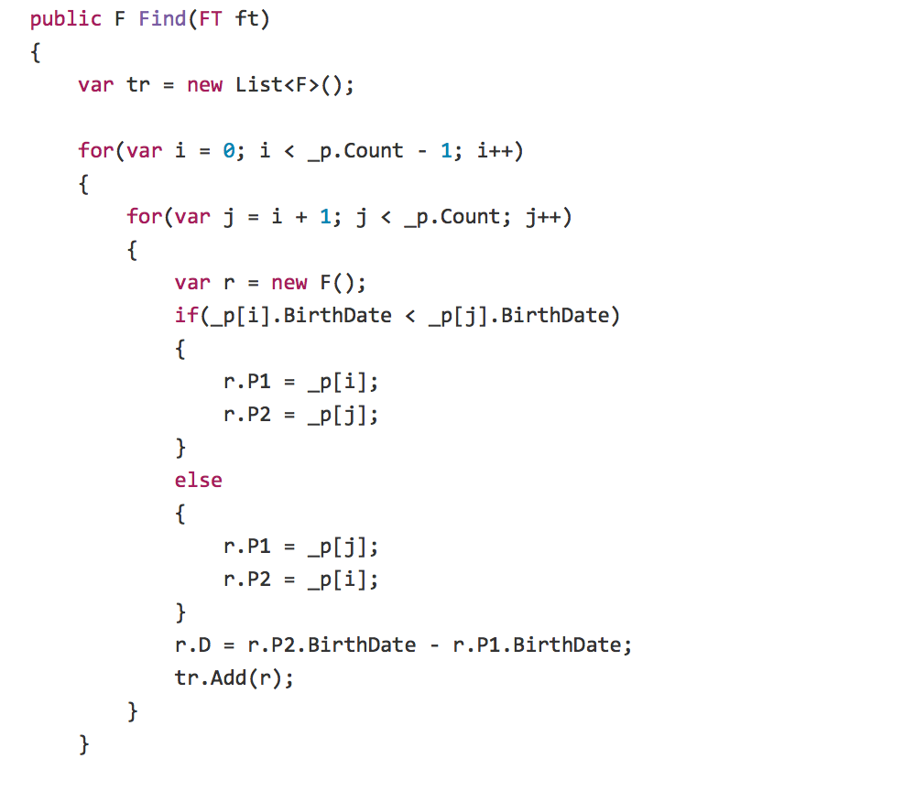
Notes:
https://github.com/OdeToCode/Katas/tree/master/Refactoring/CS

Slide 55
Getting Started
Identify change points
Find test points
We have to be sure that the behavior of the system has not changed

Slide 56
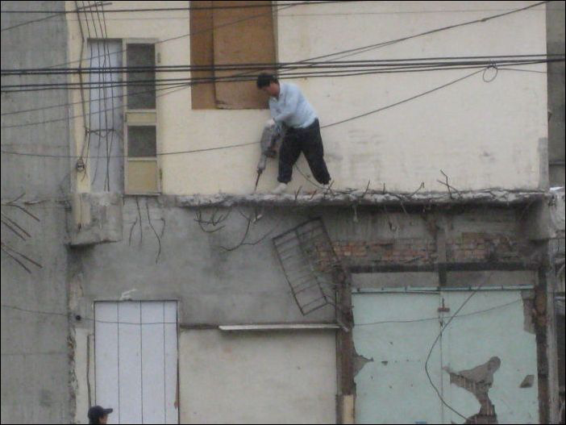
Make Sure that your changes are “safe”

Slide 57
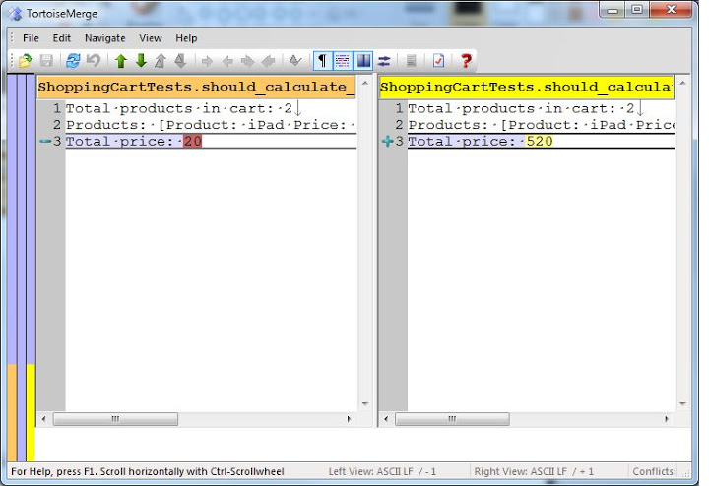
ApprovalTests

Slide 58


Slide 59
// Magic. Do not touch.

Slide 60
Integration Tests
They are good while you are changing the code.
Don’t forget to get rid of them later.

Slide 61
Getting Started
Identify change points
Find test points
Break dependencies
Can we instantiate/use class in isolation?
Can we get computation results?

Slide 62
Sensing and Separation
We break dependencies to sense when we can't access values our code computes
We break dependencies to separate when we can't even get a piece of code into a test harness to run

Slide 63
Seams
Seam: a place where you can alter behavior of your program without editing in that place
Preprocessor seams
Link seam
Object seam
http://blog.peterritchie.com/?p=2211

Slide 64
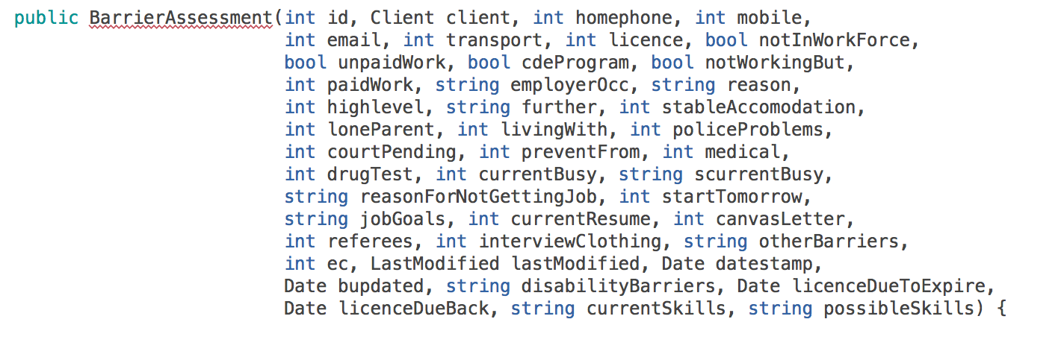
Separation
In this case we can’t create instance of the class in isolation.

Slide 65
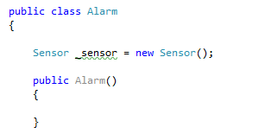
Separation
DI principle is violated

Slide 66
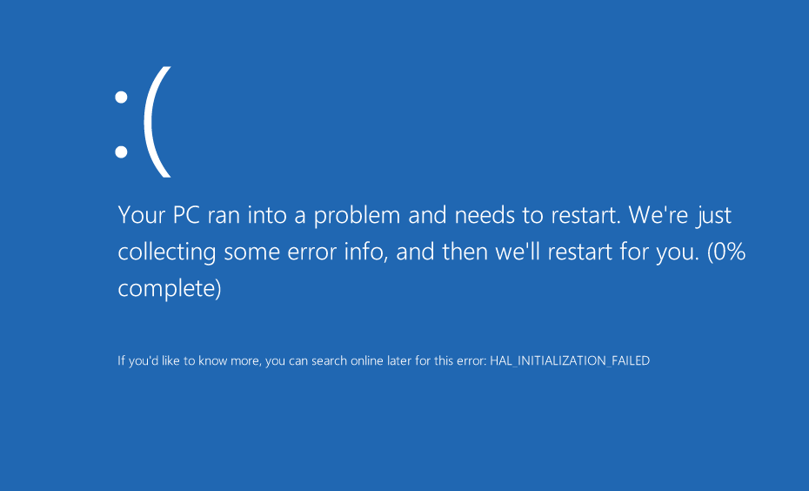
Notes:
Попытка создать класс в тесте может закончиться полным провалом

Slide 67
Getting rid of dependencies
Extract Interface & Parameterize Constructor.

Slide 68
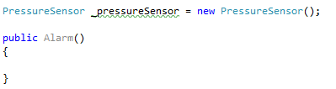
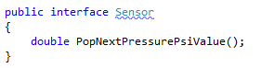
Extract Interface
Name “Sensor” is too generic in this case
Let’s extract “Sensor” interface

Slide 69
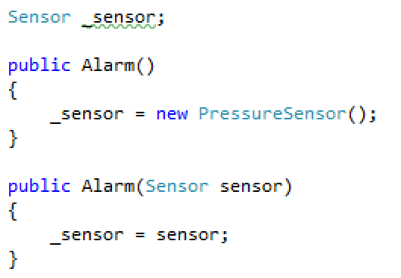
Parameterize Constructor
Default constructor still creates dependency, but we can use
“parameterized constructor” to substitute it.

Slide 70
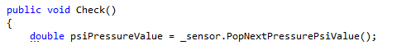
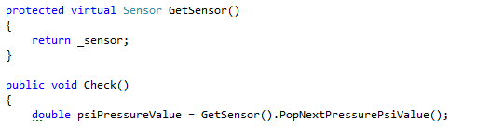
Extract and Override (step 1)
Factory Method
Old code:
New code:

Slide 71
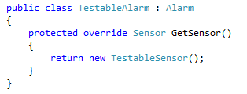
Extract and Override (step 2)
Factory Method

Slide 72
Why Extract and Override?
Changing Legacy code is risky . We have to apply the safest and the smallest changes possible.

Slide 73

Adding a method

Slide 74

Adding a method
Let’s wrap call to source.Read() with Modify() method
Safe and minimal change.

Slide 75

Overriding
Is it safe to change private to protected? Yes!
Is it safe to make method virtual? Yes!

Slide 76

Override
Now we can redefine this behavior in inherited class

Slide 77



Extract and Override
3rd party
Extract
Override
Notes:
Это пример из Blogengine.NET

Slide 78



Sensing with Extract and Override
Notes:
Это пример из Blogengine.NET

Slide 79
Getting Started
Identify change points
Find test points
Break dependencies
Write tests
Slow and complex tests are still fine here
Our goal is safety
Whatever guarantees safety is ok

Slide 80
/* This is O(scary), but seems quick enough in practice. */

Slide 81
Getting Started
Identify change points
Find test points
Break dependencies
Write tests
Make changes in small steps and refactor while changing.

Slide 82

Little Summary
Refactor early
Refactor often
Refactor on purpose
Add measurements to your process
Safety is a value
Look for tools
Learn the techniques

Slide 83
// I'm sorry.

Slide 84

Questions?

Slide 85

Thank You!

Slide 86

References
Michael C. Feathers “Working Effectively With Legacy Code”

Slide 87
Exercise
https://github.com/DmytroMindra/GildedRose

Slide 88
References
Refactoring Value or Waste
http://brodzinski.com/2012/10/refactoring-value-waste.html
Code Quality Assurance
http://www.codeproject.com/KB/architecture/Code_Quallity_Assurance.aspx?fid=441965&df=90&mpp=25&noise=3&sort=Position&view=Quick&select=2149022#xx2149022xx

Slide 89
References
http://www.trijug.org/downloads/refactor-metrics.pdf
http://www.infoq.com/news/2007/12/refactoring-is-waste
http://www.slideshare.net/yodamann/icsa-2014-mudsustaining-architecture

Slide 90
References
http://claysnow.co.uk/the-beer-belly-testing-anti-pattern/
http://www.slideshare.net/excellaco/working-effectively-with-legacy-code-15594623
http://joel.franusic.com/2015/02/27/notes-on-art-and-fear/

Slide 91
References
"A true legacy gets better with age." (y)
http://blog.8thlight.com/uncle-bob/2014/04/03/Code-Hoarders.html
http://blog.cleancoder.com/uncle-bob/2015/04/15/DoesOrganizationMatter.html
http://www.slideshare.net/kaunasjug/bye-bye-cowboy-coder-days
http://www.slideshare.net/nashjain/working-effectively-with-legacy-code-presentation
http://minds.coremedia.com/2013/08/21/sokahh-coding-dojo-legacy-code-kata/

